Slide 1
Bessere Zusammenarbeit mit OneDrive for Business Moderne Dateianhänge mit Exchange 2016 und Office 365
Exchange User Group Berlin | 22. Februar 2018

Slide 2
Thomas Stensitzki
Enterprise Consultant Granikos GmbH & Co. KG
MCT MCSM Messaging, MCM: Exchange 2010 MCT, MCSE, MCITP, MCTS, MCSA, MCSA:M, MCP
thomas.stensitzki@granikos.eu http://JustCantGetEnough.granikos.eu

Slide 3
OneDrive for Business
Ein Überblick

Slide 5
Microsoft 365: Universal toolkit for teamwork
Outlook
Office Apps
SharePoint
Yammer
Teams
Email and calendar
Co-author
Intranets and content management
Connect across
the organization
Hub for teamwork
Office 365 Groups
Single team membership across apps and services
Microsoft Graph
Suite-wide intelligence connecting people and content
Security and Compliance
Centralized policy management
Notes:
Objective: Reinforce our teamwork position - Microsoft 365 meets the diverse needs of teams with an integrated solution that is secure
We’ve designed Microsoft 365 to meet the unique needs of every group.
For each of those categories of teamwork, Microsoft 365 includes a purpose-built application.
Teams as a hub for teamwork where groups that actively engage and are working on core projects can connect and collaborate
Yammer for people to connect across their company, sharing ideas on common topics of interest
Outlook where teams can communicate in a familiar place, and can easily create modern distribution list with groups in Outlook
SharePoint for keeping content at the center of teamwork, making files, sites and all types of content easily shareable and accessible across teams
Office Apps – enabling co-authoring in familiar apps like Word, Excel, and PowerPoint
With these tools coming together in Microsoft 365 – teams get a holistic solution.
What’s unique about teamwork in Microsoft 365 is that all of these applications are built on an intelligent fabric - suite-wide membership service with O365 Groups; suite-wide discovery and intelligence with Microsoft Graph, and suite-wide security and compliance.
Office 365 Groups - A membership service providing a single identity for teams across Office applications and services
Microsoft Graph - Suite-wide intelligence that maps the connection of people and content to surface insights
Security and Compliance - Proactive security that simplifies IT management with intelligence built-in

Slide 6
SharePoint and OneDrive connect the workplace with intelligent content management and intranets
Share and work together
Inform and engage people
Transform business processes
Harness collective knowledge
Protect & manage | Extend & develop
Notes:
SharePoint and OneDrive play a special role in Office 365, by connecting the workplace with intelligent content management and intranets.
Today we’re going to focus on key areas where you can leverage our innovations to achieve significant benefits. Specifically, how you can:
Share and work together inside and outside your organization through anywhere access to your content and seamless collaboration experiences.
Inform and engage people by connecting them with the resources they need to do their jobs and fostering open conversations.
Transform business process by automating repetitive tasks and streamlining workflows.
Harness collective knowledge by making it easier to find information and expertise right when it's needed, and to encourage best practice sharing.
All with the with full confidence that you can protect and manage your organization’s content as well as extend and develop on SharePoint to meet your unique business needs. Let’s get started!

Slide 7
SharePoint and OneDrive cloud momentum
300k
85%
65%
organizations
of Fortune 500
of all seats are online
90%
300%
7x
growth in active users
growth in sync usage
Gartner & Forrester Leader
Notes:
As we discussed at Ignite, we have seen significant increases in customer adoption. As per our most recent earnings announcement, Office 365 now has over 120M active users.
Given email's pervasiveness, Exchange has the most active users, but SharePoint is the clear number 2 in O365 and growing faster than ever.
We are excited the cloud allows more companies to get more value, with more agility and less cost which is why SharePoint is gaining 100s of thousands of NEW customers.
But this isn't just small businesses – over 85% of the Fortune 500 have SharePoint and OneDrive in Office 365.
We’ve also crossed the tipping point and now over 65% of SharePoint seats are online.
But what is even more exciting to us is the increase in usage over the past year including a 90% increase in active users and a 300% increase in the usage of our OneDrive sync client.
We’ve been extremely focused on giving customers a rock-solid sync experience for all their files in the cloud and that gets even better with Files On-Demand now in Windows 10.
I’m also humbled to see the recognition by the press and analysts. SharePoint and OneDrive are now leaders in 7 Gartner Magic Quadrant and Forrester Wave reports.
This includes Gartner’s recent Content Collaboration Platform MQ report where Microsoft, with OneDrive in Office 365, was ranked as a leader with a higher ability to execute than any of our competitors (incl. Google, Box and Dropbox)
It’s these types of results that keeps us energized and firing on all cylinders to deliver new value to our customers each and every month.

Slide 8


OneDrive with Office 365
Share and work together on all your files
Access files from all your devices
Share inside or outside
your organization
Collaborate with
deep Office integration
Quickly find files
that matter most
Protect your work with enterprise grade
security and compliance
Notes:
OneDrive with Office 365 allows you to share and work together on ALL your files. This include your personal files and files shared with you in Office 365. And you can access those files from any device including mobile, PC, Mac or via a web browser.
Since most of us don’t work in a silo, OneDrive makes it simple to share files inside and outside your organization with a common sharing experience that we are bringing across web, desktop, mobile and to the back stage of Office. You can even securely share files with people that don’t have a Microsoft Services Account (MSA) using email verification to prove their identity. We realize administrator are concerned with the risk of data leakage so OneDrive gives them visibility and control they need to manage this through the OneDrive Admin Center.
Who has used co-authoring in Word, Excel or PowerPoint to work together on the same file in real-time? It’s a game changer for improving teamwork. (if they haven’t heard it explain it). Only with OneDrive can you co-author documents using the Office web apps AND Office mobile apps AND desktop Office clients for Windows. You can’t do that with your files stored on files shares, Box, Dropbox, or in Google Drive.
Finding content is one of the biggest inefficiencies we have on a daily basis and with OneDrive we want to help you quickly find the files that matter most. Using the intelligence of the Microsoft Graph, you’re able to get back to your recent files, files that have been shared with you, or recommended files based on your working relationships with others. These personalized recommendations can help you discover content you might not have been aware of and is unique to OneDrive and Office 365.
Lastly, you can rest easy storing your files in OneDrive where files are protected by our enterprise grade security and compliance features.
Now let me dive a little deeper into each of those areas with a demo and our upcoming roadmap for OneDrive.

Slide 9
PDF previewer + PDF conversion
View Office docs in app
ODB push notifications
Discover view V2​
Me tab (mobile)
My analytics (mobile)
iMessage support
New sharing dialog in ODB/SPO
“Get a link”—Share from Explorer/Finder
New sharing experience (Explorer and Finder, Win32 W/E/P, Web W/E/P, Web, Mobile—ODB and SPO)
OCS (Office collab service) support
ODB file handlers preview
Sites in ODB
250+ new web viewers (including 3D, etc.)
Office instant previewers (Word, PPT)
Office unified apps (Word, PPT)
ODB new shared with me, shared by me
ODB access stats on file, activity feed
ODB flow integration
At-a-glance sharing information on any folder
ODB/SPO revamped sharing mails
Shareable links for ODB folders
Shareable links (web, mobile, sync)
Sharing warnings for large scale disclosure
Beautiful OneDrive link previews in OWA (ODC and ODB)
Outlook (web, Win32, iOS, Android) cloud attachments default to user-friendly permissions (works like regular attachments)
ODB sharing notifications on mobile
Share (ODC, ODB) and edit (ODC) notifications in WEP
Owners can require approval for reshares
Notifications on re-sharing
See who has opened sharing links (web)
Sharing mails come from users mailbox
Recipients of sharing emails know whether links are re-shareable
Respond to access requests directly from Outlook
@mention and email notifications for Win32 Word
Developer, photos
OneDrive API for On Prem
Albums and bundles for photos
API optimizations for mobile
Links open right
SharePoint sites in graph
SharePoint lists in graph
OneDrive Dev Portal migrates to MS Graph Portal
S2S auth support for API
File versions API
Animated GIF support (mobile)
Clean up space on Android
Office lens integration
ODB video streaming (mobile, web)
Camera roll upload on HoloLens
Team sites sync
Mobile team sites support
Marquee select + design updates (mobile)
3D touch support
Mobile Single Sign On (W/X/P/ON, Outlook, Skype for Business, SharePoint, ...)
Mobile On Prem support
Xbox One App
Conditional access for Sync (preview)
Location-based CA (mobile)
PowerLift integration
Support for Visio handoffs (mobile)
Document picker support (iOS)
Voice commands on HoloLens
Files On-Demand preview​
Pause sync
OCSI (MSI, consumer C2R, and team sites)
Office centennial sync integration
Mac standalone SKU
IRM sync (preview)
“Report a problem”
File overlay repair
Real-time telemetry pipeline (Sync)
Windows Telemetry updates/compliance
Multi-geo support
Go Sov support
1ES engineering pipeline
Accessibility Grade B (All)
#, % name support
MAX_PATH support
Windows information protection (UWP, Sync)
New ODB admin portal
New Windows RS2,3 OOBE
Modern details pane (web)
ODC Realtime web updates; ODB MVP
Download multiple files
1-UppPreviewer UX polish and performance
ODB search result filtering
ODB new list, grid, and recent UX
EU cookie regulation support
Files On-Demand tutorial
ODB/SPO file zip viewer
Admins can
Prevent external users from re-sharing
ODB and SPO respect Exchange AB policy
Block external users from seeing each other
Limit external sharing to specific users
Block sharing of sensitive documents externally
Limit anonymous links to specific users
Require external users to re-verify email every 30 days
All photos performance
ODB image object detection
New File Picker (including SharePoint Site)
Over 100 new features and functionality added this year
Notes:
Since Jan 2017, we have brought over 100 new pieces of functionality and features to OneDrive. This spans from the addition of an OneDrive Admin console to a unified sharing experience that extends not just to Windows, Mac and Web but to SharePoint and Office 365.
What is really amazing is that….

Slide 10

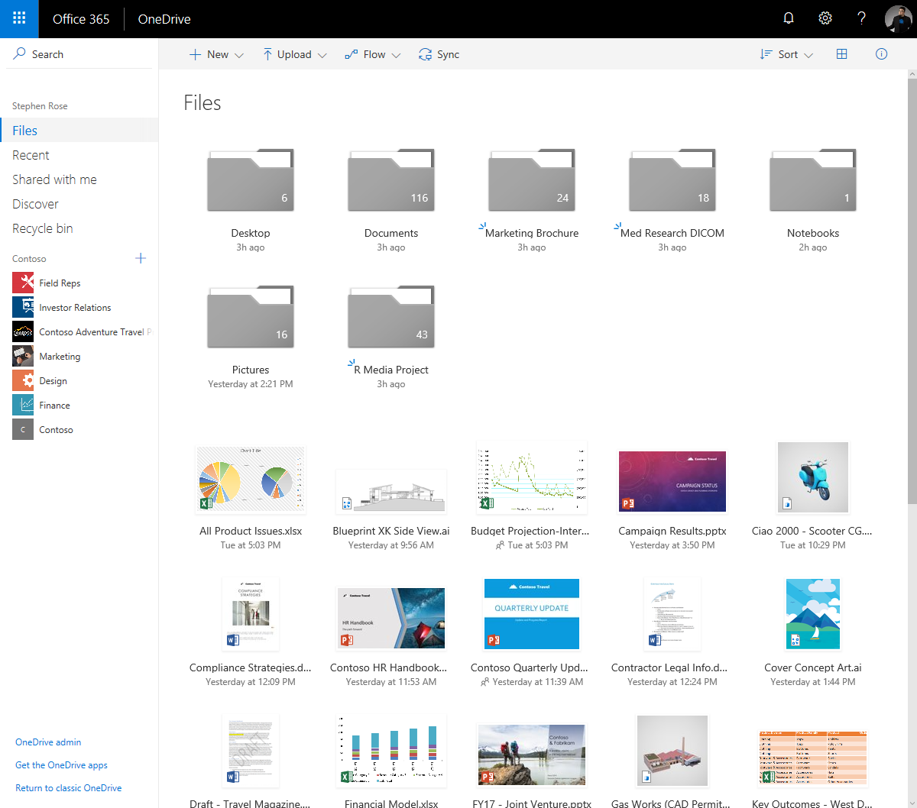
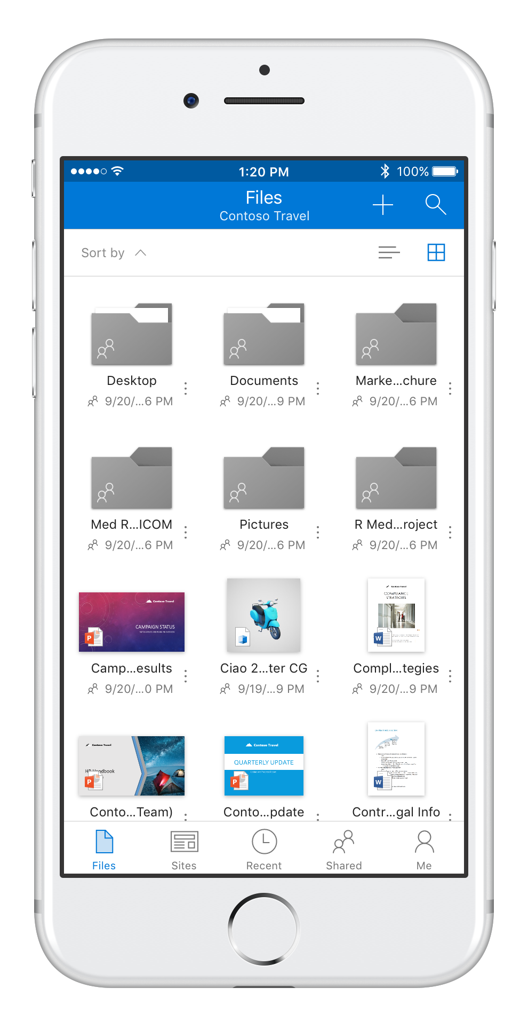
Access files from all your devices
Full fidelity web experience with preview support for 270+ file types and growing
Work from the desktop and offline with robust sync options for PCs and Macs, incl. Files On-Demand in Windows 10
Work from anywhere with 4+ rated mobile apps on iOS and Android
Access personal and shared file from OneDrive and SharePoint
Notes:
We offer the ability for end users to preview over 270 different file types including Adobe formats, 3-D and DICOM Medical Images to name a few all without needing an installed application. We are adding more viewers everyday.
Our goal has been to make the experience ubiquitous no matter what platform you are using from Mac and Windows to iOS and Android. One experience to rule them all.

Slide 11
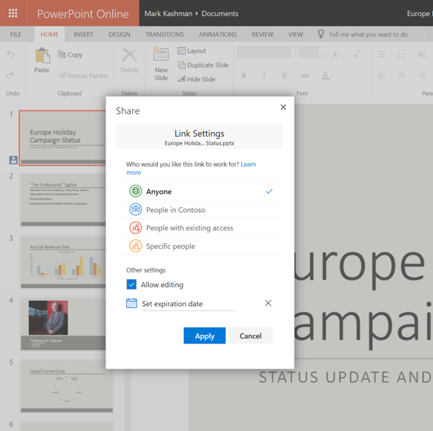
Collaborate with deep Office integration
Share seamlessly and consistently
Open documents faster than ever in Office web apps
Co-author documents in the Office web apps, desktop clients and mobile apps
Notes:
Ask who does real time co-auth. <wait for raise of hands> It’s a game changer, right? Well only with OneDrive can you collaborate real-time using the Office web apps AND Office desktop clients. You can’t do that with your files stores on files shares, Box, Dropbox, or in Google Drive.
We also make it simple to share inside and outside your organization with a common sharing experience we are bringing across web, desktop, mobile and the back stage of Office. It’s also common across SharePoint files.
And when you are sharing externally with those that don’t already have a Microsoft Services Account, we’ve made that easier with an simple email verification.
We are also making it easier to share in email, not by adding addition steps but by modifying the ingrain behavior of how people share file attachments with what we call modern attachments that include links to cloud files and automatically provision the right file access.

Slide 12
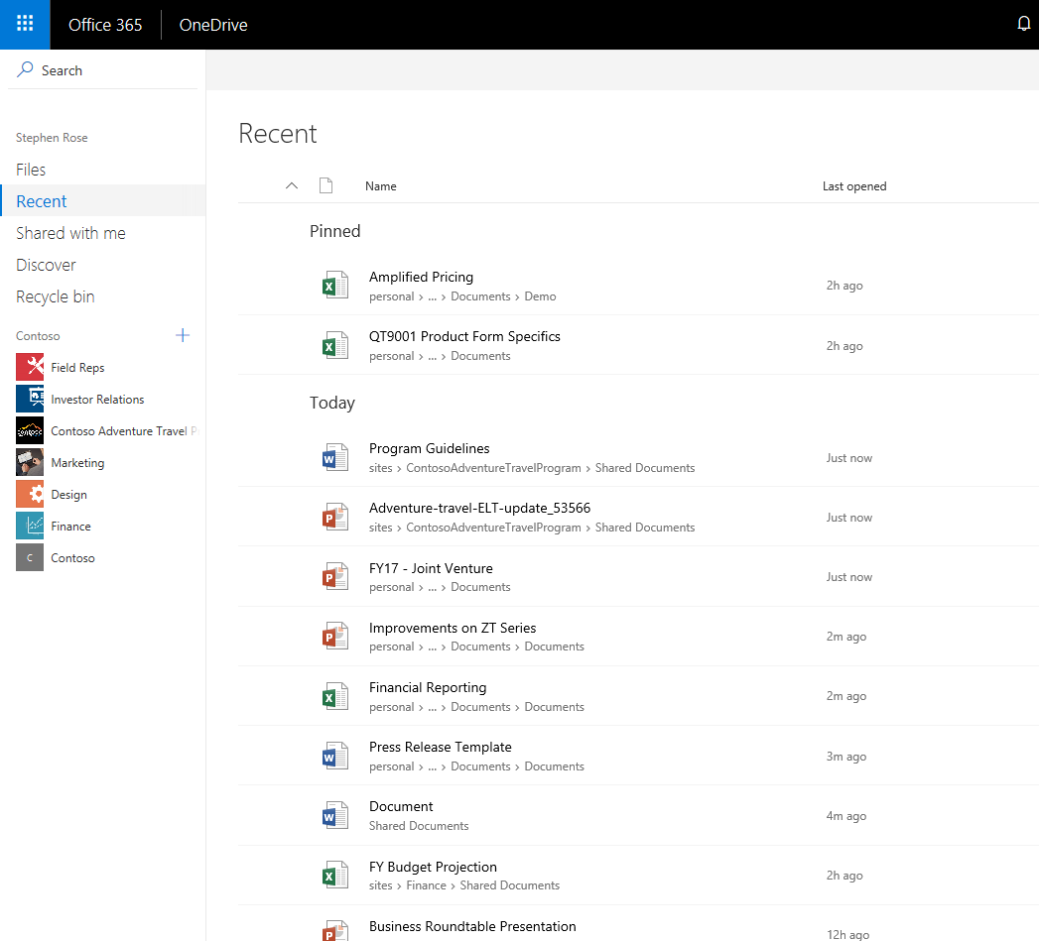
Quickly find files that matter most
Leverage the intelligence of the Microsoft Graph by storing your files in OneDrive
Get back to your recent and pinned files on the web, mobile, or directly in Office
Easily return to files shared with you
Discover files and get personalized search results from people and sites relevant to you
Notes:
Finding content is one of the biggest inefficiencies we have on a daily basis and with OneDrive we want to help you find your files fast. This is powered by the intelligence of the Microsoft Graph and only available for your OneDrive files. Not your files stored in Box, not your files stored in Dropbox, and definitely not your files stored in Google Drive.
Get back your recent files easily across web, mobile and Office. Opening my recent files from the Word, PowerPoint and Excel backstage or jump list is my go to now.
Once files have been shared with you, you can easily get back those.
We also are personalizing your search results using the signals in the Microsoft Graph. So when you search, files from people in your org structure or those you collaborate with will get a higher relevance than others.
And lastly we want to help you discover files you didn’t know existed. By using those same signals we can show you trending files around you in the Discover view of OneDrive, in Delve, or the people cards across Office 365.
Remember the Microsoft Graph respects privacy, so that only those files you explicitly share will be visible.

Slide 13
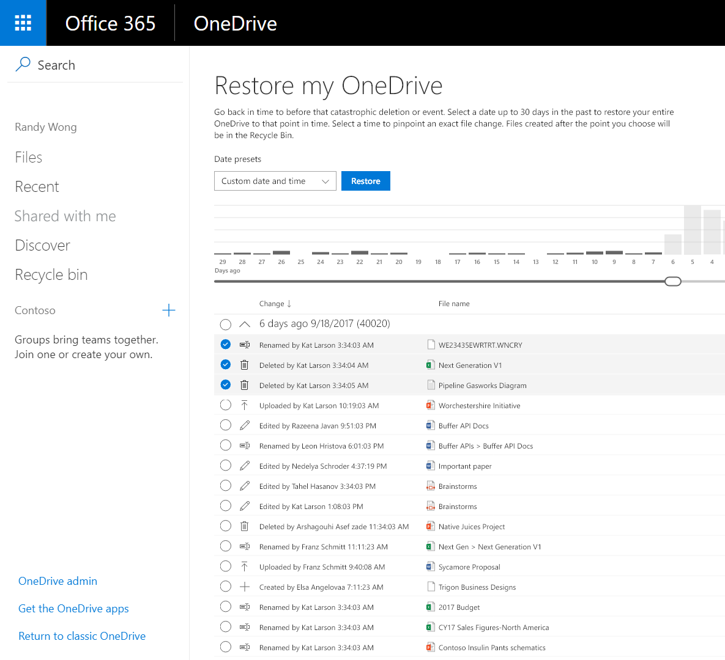
Protect your work
Files are encrypted at rest and in transit
Undo or rollback changes using the recycle bin and version history
Recover from mass file corruption with self-service restore
Be notified of file access
Notes:
Security of your data is critical. With new features like IRM sync, Multi Geo capabilities as well the ability to hold your own Azure encryption key are critical to admins. For end users, we want to ensure it’s not just secure, but in the case of a damaged file or malware, that you can get back to where you were at with just a few clicks.

Slide 14
Keeping your data safe
Files
Your files are the heart of your business
Losing content
Can disrupt or destroy productivity
INTRODUCING FILES RESTORE
Allowing self service recovery for the last 30 days up to the second
Recover from accidental deletes, corruption, or ransomware events
Notes:
From corruption, to ransomware, to just accidental deletion—losing content can completely disrupt a business. The recent issues with WannaCry and other ransomware attacks showed just how disruptive it can be.
Keeping your data safe has always been a top concern. While SPO has always had a support-driven process to recover content it can take days or weeks and multiple hops to go through. That is why we are so excited to announce this week “Folder Recovery”. A complete self-service recovery solution to allow content owners to go back in time to any second in the last 30 days. Now your users and your administrators can rewind changes using activity data to find the exact moment to revert to.

Slide 15
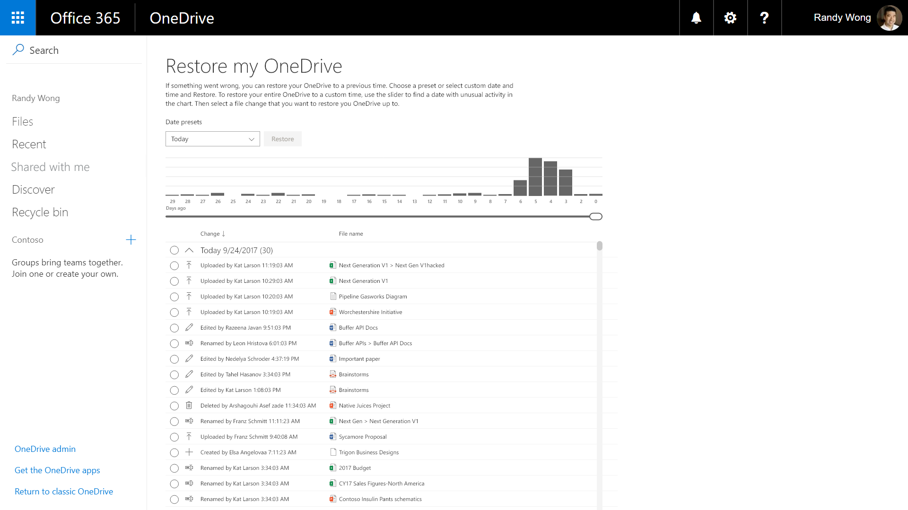
Notes:
Files Restore is accessible to all end users. Think of it as a restore to my restore. An end user can go in here an pick any point in time over the past 30 days…

Slide 16

Notes:
They can then pick the files they want to restore from that time period..

Slide 17

Are you sure you want to restore your OneDrive?
Restoring your OneDrive to 8/12/2017 3:49:02 PM will revert 2300 changes.
Restore
Cancel
Notes:
And…. Restored.
This feature will be available to business users in early Jan

Slide 18
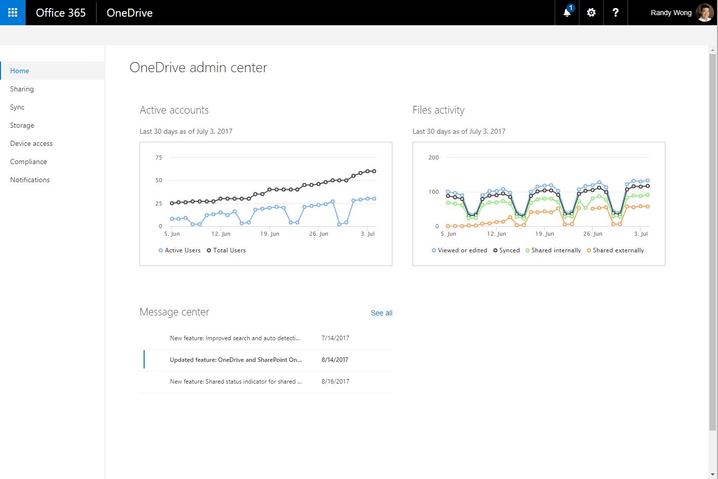
Protect and manage for admins
Rest easy with global scale, reliability, and compliance
Protect your files with sharing and security controls in the OneDrive admin center
Apply conditional access policies
Bring Office 365 to your datacenter with hybrid capabilities
Comply with data residency requirements with multi-geo support

Slide 19
Roadmap—OneDrive
 | FUNDAMENTALS | SYNC AND MOBILE | COLLABORATION AND SHARING | SECURITY AND ADMIN
LATE CY2017 | File hover card Microsoft Flow integration Zip file support Photo intelligence | Files On-Demand New file previewers Support for on-premises with Android app | Secure external sharing | Multi-geo (private preview) Service level encryption (private preview)
EARLY CY2018 | Move from OneDrive to SharePoint Mac Office co-authoring | IRM library sync Mac Office sync integration (preview) Improved end user onboarding on mobile Additional file preview support on mobile | External sharing reports Comments on non-Office files Shared by me Updated mobile sharing Shared with me on mobile (updated UI) | Files restore Sync conditional access Files On-Demand admin controls Full ITAR and multi-geo support on mobile

Slide 21
Moderne Dateianhänge

Slide 22
Demo

Slide 23
OneDrive Next Steps
Go to onedrive.com/business to learn more
Engage with us and the community at techcommunity.Microsoft.com/onedrive
Get onboarding and adoption assistance at fasttrack.microsoft.com
Leverage the OneDrive help center at
support.office.com/onedrive
Provide product feedback at onedrive.uservoice.com

Slide 24

Thomas Stensitzki
Granikos GmbH & Co. KG
MCT MCSM Messaging, MCM: Exchange 2010 MCT, MCSE, MCITP, MCTS, MCSA, MCSA:M, MCP
thomas.stensitzki@granikos.eu http://JustCantGetEnough.granikos.eu

Slide 25

OneDrive Umfrage
Thomas Stensitzki
Granikos GmbH & Co. KG
MCT MCSM Messaging, MCM: Exchange 2010 MCT, MCSE, MCITP, MCTS, MCSA, MCSA:M, MCP
thomas.stensitzki@granikos.eu http://JustCantGetEnough.granikos.eu
http://bit.ly/ODB-EXUSG
Notes:
QR Slideshare

